Slide 1
Task 3
NEHA J

Slide 2
Objective
Purpose of dashboard:
To design an interactive dashboard for sales and profit analysis to assist business stakeholders in decision-making.
Key goals:
Track total sales, profit, and quantity sold
Compare performance by category, sub-category, state, and payment mode
Analyze sales trends over time
Identify top-performing products and regions

Slide 3
Data Source
Dataset: Sales Dataset.csv
Records: 1,194 rows
Time period: Based on Order Date (2021–2024)
Key fields:
Numerical: Amount, Profit, Quantity
Categorical: Category, Sub-Category, Payment Mode, State, City
Date fields: Order Date, Year-Month

Slide 4
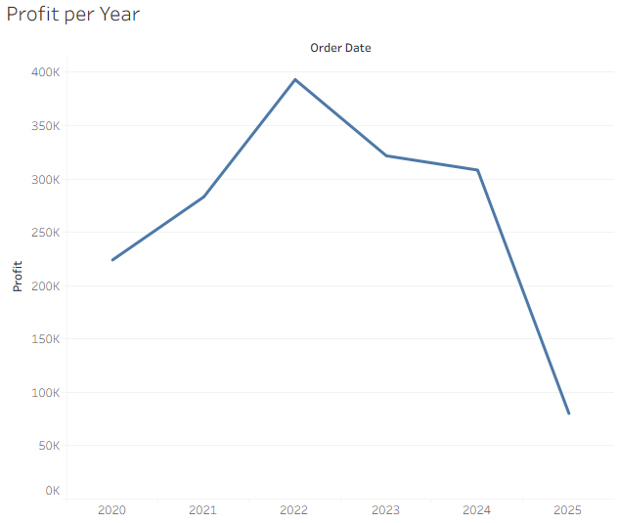

Slide 5
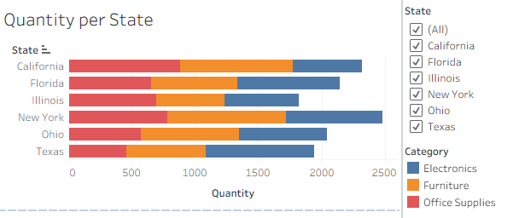

Slide 6
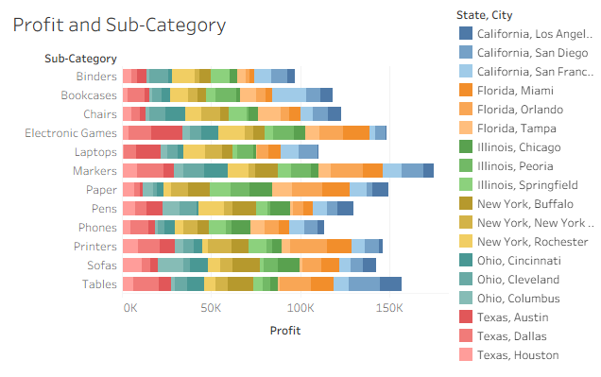

Slide 7
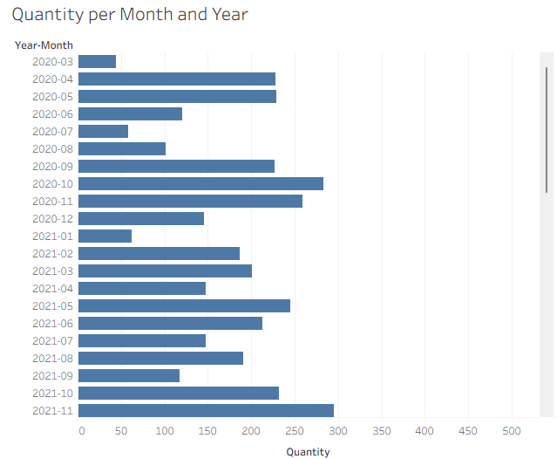

Slide 8
Insights and Observations
Electronics category had the highest total sales
Certain states (e.g., Florida, Illinois) are top revenue contributors
Sales show seasonal spikes in specific months (e.g., June, December)
Some categories have high sales but low profit margins

Slide 9
Conclusion
Dashboard enables quick tracking of sales & profit performance
Insights can help prioritize high-margin categories and top regions
Seasonal trends can guide inventory and marketing planning
Recommended next step: deeper customer segmentation & predictive sales modeling

